Slide 1
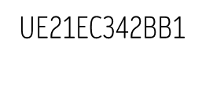

TRIVIUM CIPHER
ARCHITECTURES FOR HARDWARE ACCELERATION
TEAM MEMBERS:​
DHANUSH D : PES1UG21EC082
ESTARTH GUPTA : PES1UG21EC096
G SSS DHANVI : PES1UG21EC104
HEMANT C WADE : PES1UG21EC112

Slide 2
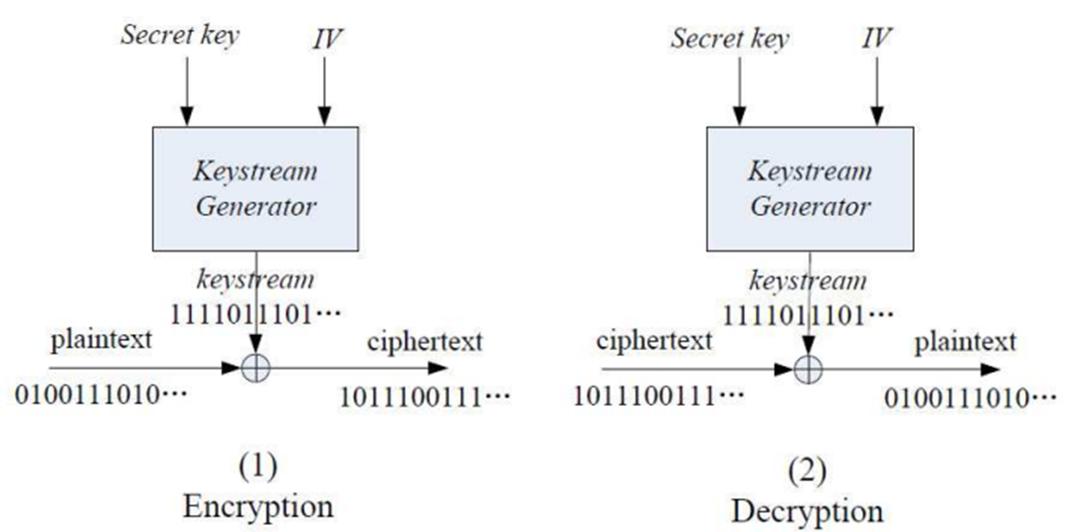
What is cipher ?
A stream cipher is a symmetric encryption algorithm which takes a stream of plaintext, a secret key and an IV as input and then operates the plaintext with key stream generated by the key and IV, typically bit by bit

Slide 3
Terminologies
The secret key and Initialization Vector are of fixed length and used to initialize the state of key stream generator, the key part of a stream cipher.
There are many strategies and ways to design a secure and efficient key stream generator, including :
LFSRs (Linear Feedback Shift Registers)
FCSRs (Feedback with Carry Shift Registers )
NLFSRs (Non Linear Feedback Shift Registers)
T-functions and so on

Slide 4
Where is it used ?
1.Exceptional encryption performance in software, where the luxury of additional hardware is not available to speed up encryption.
2.In any reasonable kind of encryption performance in hardware environments where the available resources such as gate count or power might be heavily restricted. The extreme example of this is provided by simple RFID tags.

Slide 5
Trivium
Trivium is one of the promising new stream ciphers in the hardware oriented profile.
Trivium is designed to generate up to 288 bits of key stream from an 80-bit secret key and an 80-bit initial value (IV).
The process consists of two phases:
first the internal state of the cipher is initialized using the key and the IV,
then the state is repeatedly updated and used to generate key stream bits.
There are 288 bits in the internal state.

Slide 6
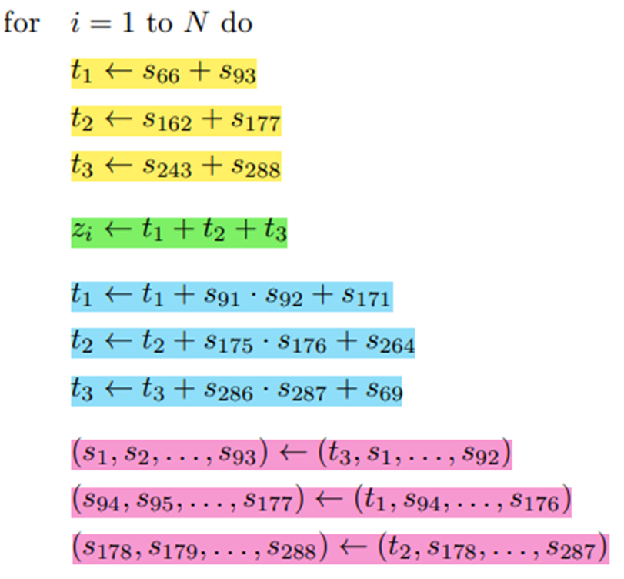
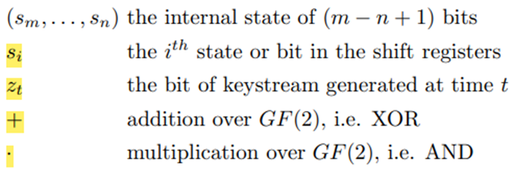
Key stream generation
Notations:

Slide 7
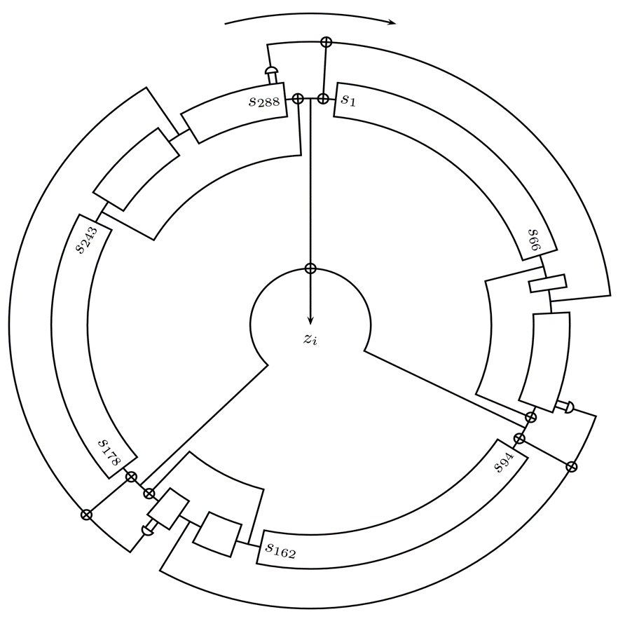
Trivium structure:
The state is rotated over 4 full cycles after the loading of key and IV.
4 full cycles means 4 ∗ 288 = 1152 clock cycles

Slide 8
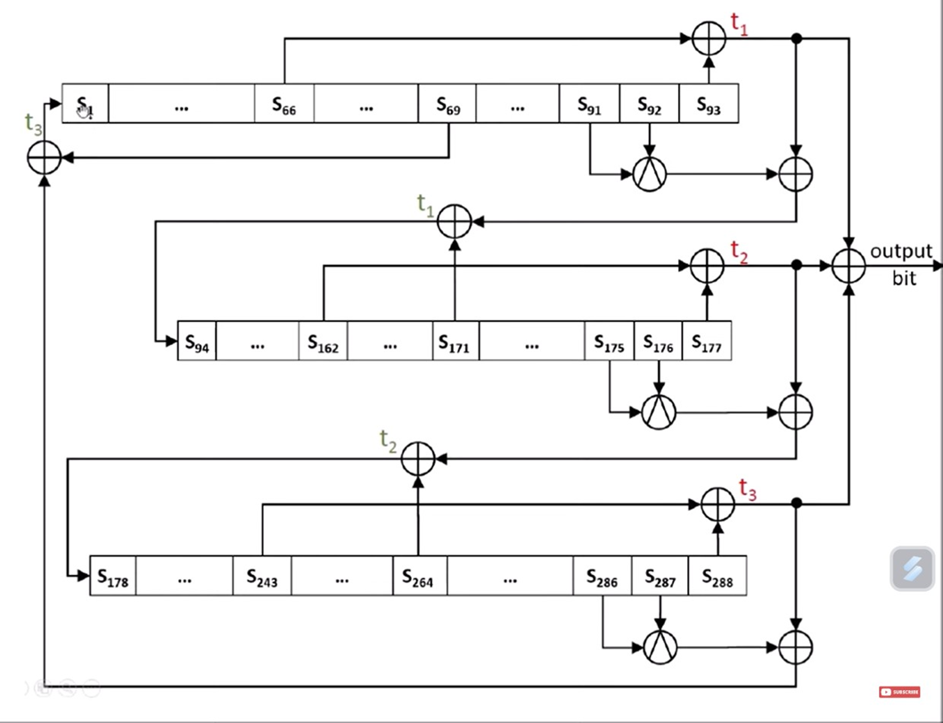
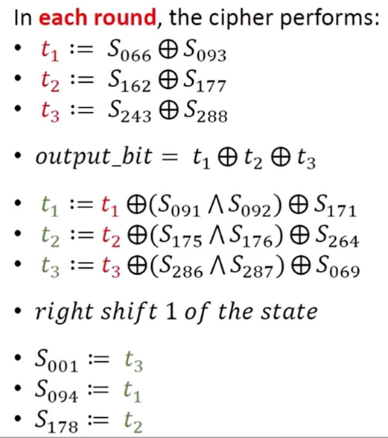
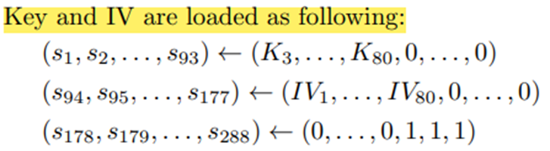
Working:

Slide 9
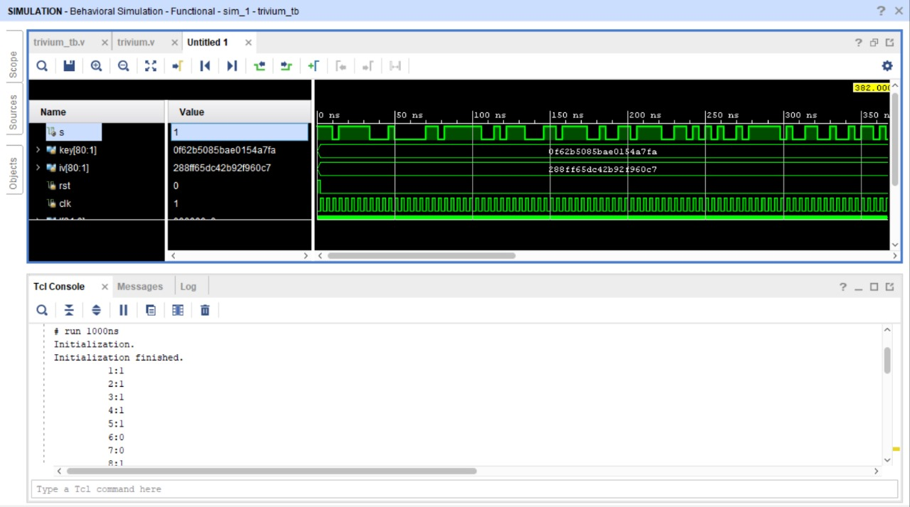
Verilog implementation

Slide 10
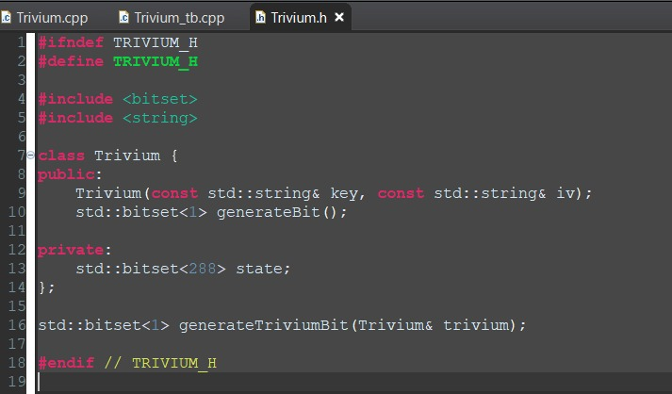
SYSTEM C CODE:
Header file code

Slide 11
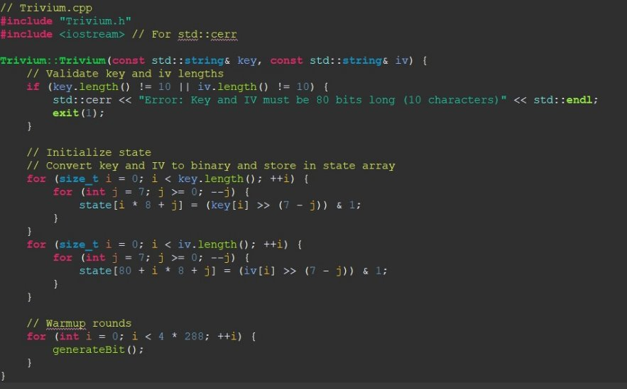
Design Code

Slide 12
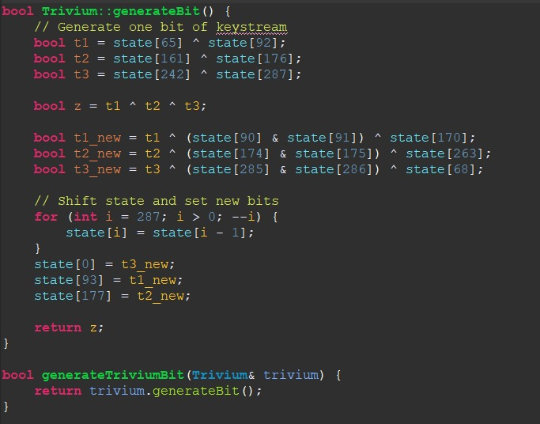

Slide 13
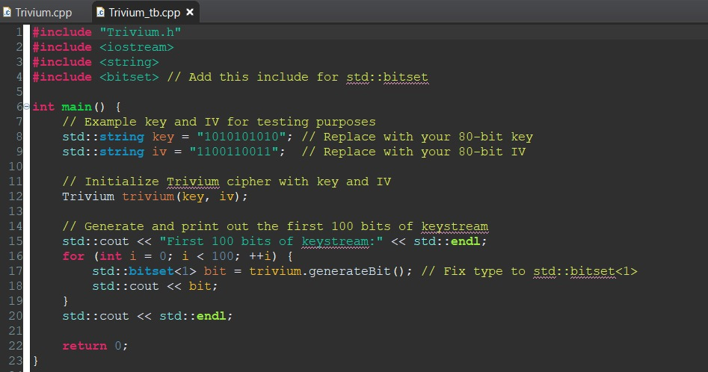
Testbench code

Slide 14
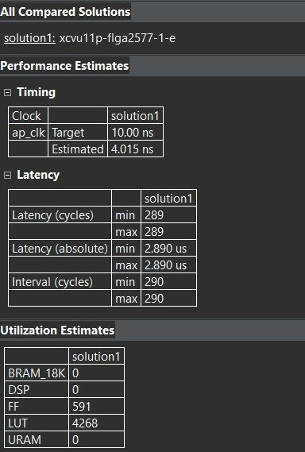
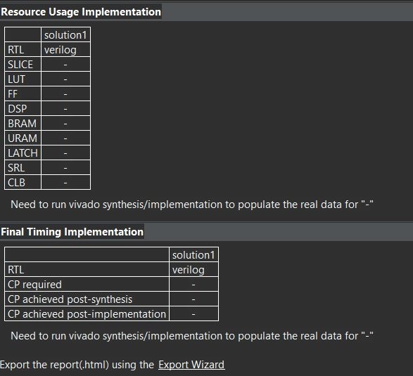
Run Synthesis

Slide 15
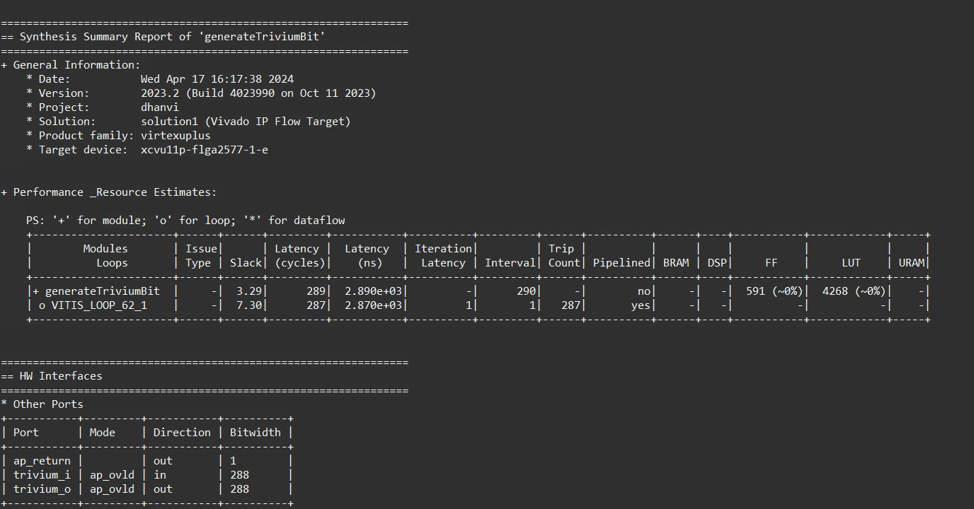
Synthesis Report

Slide 16
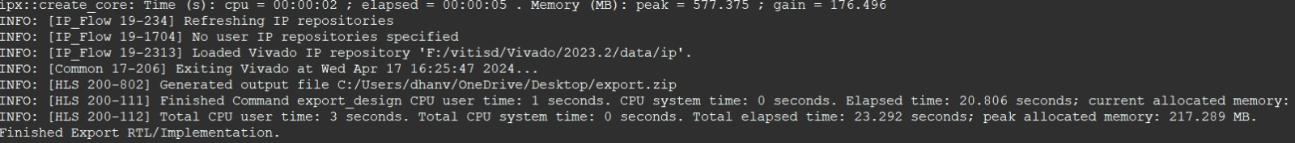
Exporting RTL

Slide 17
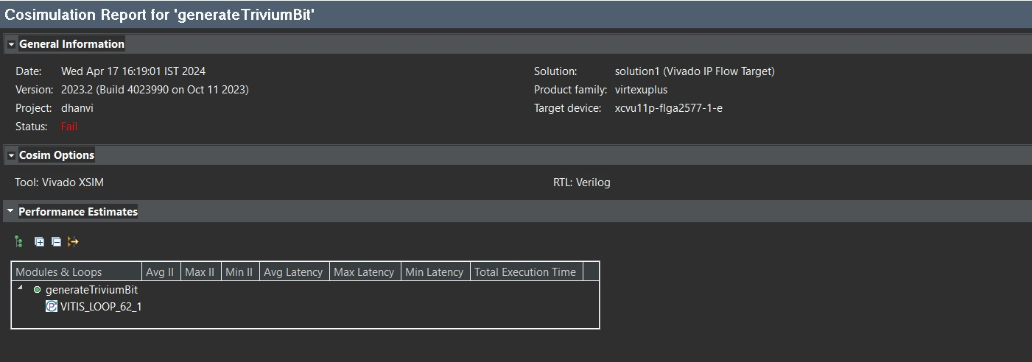
Cosimulation report

Slide 18
Error

Slide 19
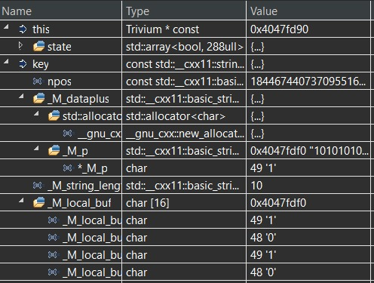
Register contents

Slide 20

THANK YOU

